Slide 1
Instruction Pipeline Design
In instruction pipeline design, a stream of instructions can be executed by overlapping fetch, decode and execute phases of an instruction cycle.
This type of technique is used to increase the throughput of the computer system.
An instruction pipeline reads instruction from the memory while previous instructions are being executed in other segments of the pipeline. Thus, we can execute multiple instructions simultaneously.
The pipeline will be more efficient if the instruction cycle is divided into segments of equal duration. In the most general case computer needs to process each instruction in following sequence..
Fetch the instruction from memory (FI)
Decode the instruction (DA)
Calculate the effective address
Fetch the operands from memory (FO)
Execute the instruction (EX)
Store the result in the proper place.

Slide 2
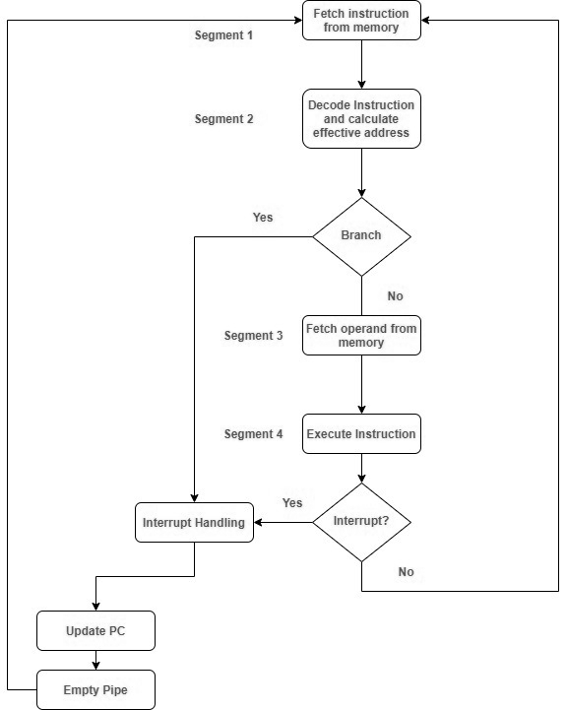
Flowchart of instruction pipeline

Slide 3
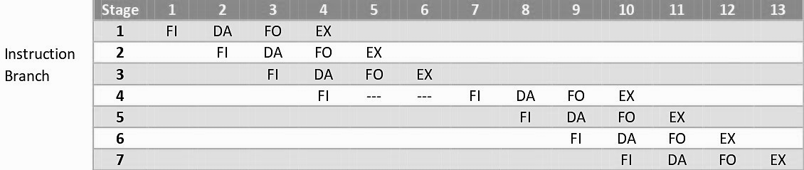
Example of Pipeline instruction
Here the instruction is fetched on first clock cycle in segment 1. Now it is decoded in next clock cycle, then operands are fetched and finally the instruction is executed. We can see that here the fetch and decode phase overlap due to pipelining. By the time the first instruction is being decoded, next instruction is fetched by the pipeline. In case of third instruction we see that it is a branched instruction. Here when it is being decoded 4th instruction is fetched simultaneously. But as it is a branched instruction it may point to some other instruction when it is decoded. Thus, fourth instruction is kept on hold until the branched instruction is executed.

Slide 4
Arithmetic Pipeline
An arithmetic pipeline divides an arithmetic problem into various sub problems for execution in various pipeline segments.
It is used for floating point operations, multiplication and various other computations. The process or flowchart arithmetic pipeline for floating point addition is shown in the diagram.
The floating point addition is shown using arithmetic pipeline:

Slide 5
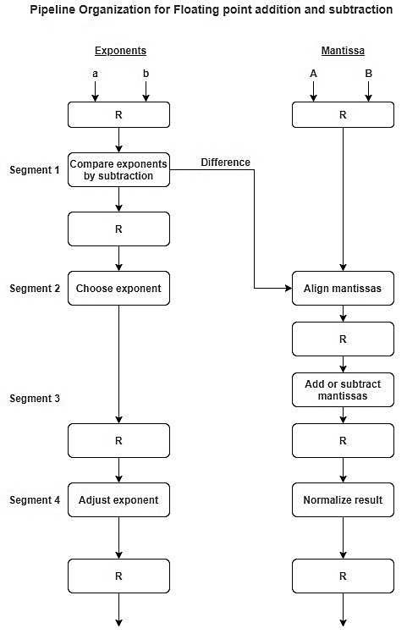

Slide 6
The following sub operations are performed in this case:
Compare the exponents.
Align the mantissas.
Add or subtract the mantissas.
Normalise the result.
First of all the two exponents are compared and the larger of two exponents is chosen as the result exponent. The difference in the exponents then decides how many times we must shift the smaller exponent to the right. Then after shifting of exponent, both the mantissas get aligned. Finally, the addition of both numbers take place followed by normalisation of the result in the last segment.

Slide 7
Example:
Let us consider two numbers,
X=0.3214*10^3 and Y=0.4500*10^2
Explanation:
First of all the two exponents are subtracted to give 3-2=1. Thus 3 becomes the exponent of result and the smaller exponent is shifted 1 times to the right to give
Y=0.0450*10^3
Finally, the two numbers are added to produce
Z=0.3664*10^3
As the result is already normalized the result remains the same.

Slide 8
Example:
Let us consider two numbers,
1.
X=0.9504*10^3 and Y=0.8200*10^2
Add and subtract using arithmetic pipeline principle and normalize the result. Identify mantissa and exponent after normalization.
2. X=0.9504*10^3 and Y=0.4350*10^2

Slide 9
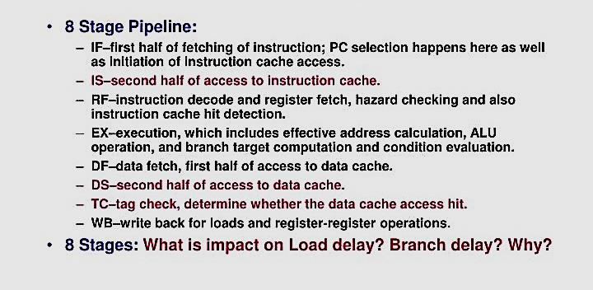
MIPS R4000 instruction pipeline

Slide 10
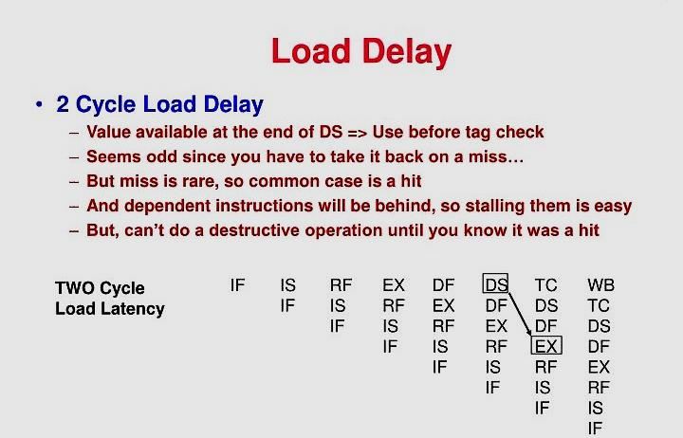

Slide 11
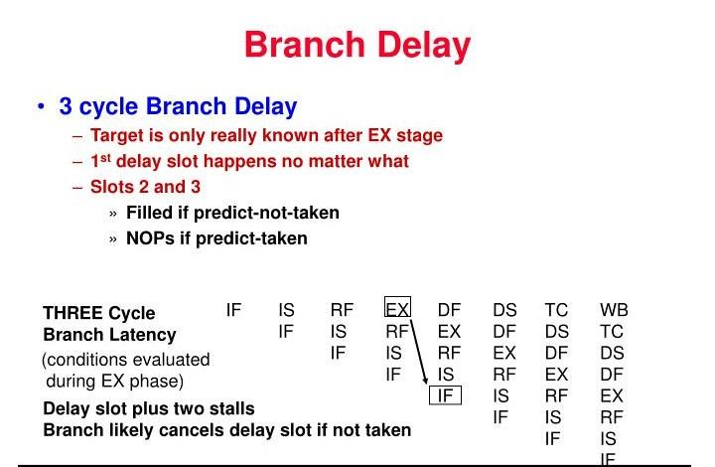
Two delay slots occur regardless of the branch outcome
which can be filled with NOP instructions if the branch is
predicted as taken. The delay slot instructions is cancelled
if branch is determined to be not taken.

Slide 12
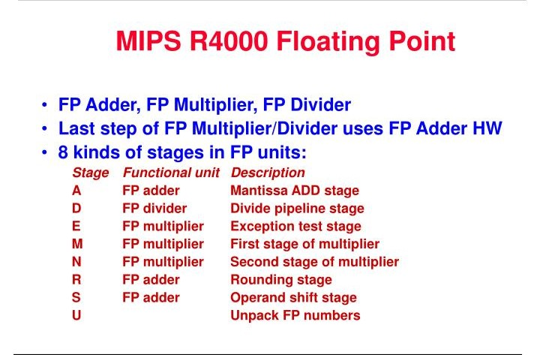

Slide 13
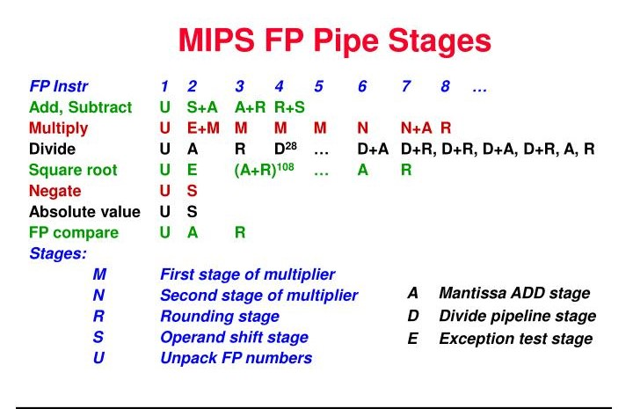

Slide 14
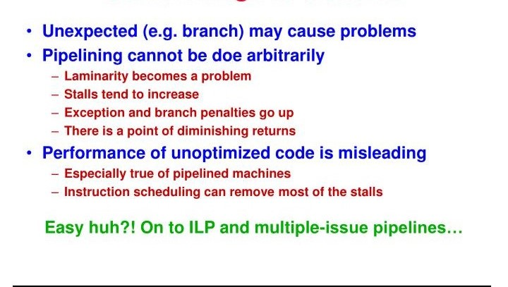
Drawbacks of R4000

